Slide 1

Reducing Credit Card Churn (Attrition)
Credit Card Churn Reduction Data Analysis
Reed Iredale for Macquarie Bank Credit Card Team
January 2022

Slide 2
The Agenda
We’ll Have Questions in the End
Situation Appraisal
Business Question
Data Pipeline
Exploratory Data Analysis
Hypothesis Testing
Moving to a Desired Future State
Future Business Questions
Q & A

Slide 3
Situation Appraisal
Giving Business Context Before Diving into the Data
Macquarie Bank’s CEO is uncomfortable with more and more customers leaving the business due to credit card products. The Credit Card Manager would really appreciate it if someone could predict which segment of customers will churn so that they can proactively go to those customers to provide them with better products and services so they don’t leave the business.

Slide 4
Can We Reduce Churn on Macquarie Bank Credit Cards?

Slide 5
Data Pipeline
The Data Process to Better Decision-Making
Define
Objectives
Metrics
Value
Prepare
Wrangle
Clean
Munge
Analyse
Predict
Revise
Evaluate
Deliver
Visualise
Summarise
Advise

Slide 6
Why is Churn Important?
Reasons a Customer Might Churn
You might be attracting the wrong customer
Your customers aren’t achieving their desired outcome
Your customer support might need work
Your customers think your competitors can do a better job
Your product is flawed
Your customers no longer see value in the product
Your customers think your product is too expensive

Slide 7
Data Summary
10,000 Rows, 23 Features, Sample Sourced from Accounts Receivable
Attrition Flag (Customer Churned or Not): This is our target variable, whether our customer has left the organisation or that they are still an active customer
Gender: Male or female
Customer Age: Age of the customer
Income Category (4 Categories): To which income category does the customer belongs to.
Card Category (4 Cards): Which card category does the customer have?
Months Inactive: Amount of inactivity when using the credit card.
Credit Limit: Credit Limit the customer currently has.
Total Revolving Balance: The unpaid portion that carries over to the next month when a customer does not pay.
Average Utilisation Ratio: Measures how much credit you are using compared to how much you have available.
Open to Buy: The amount of credit available at a given time on a credit card holders account. Thus, the average open to buy is the average credit available allocated to a specific customer.

Slide 8
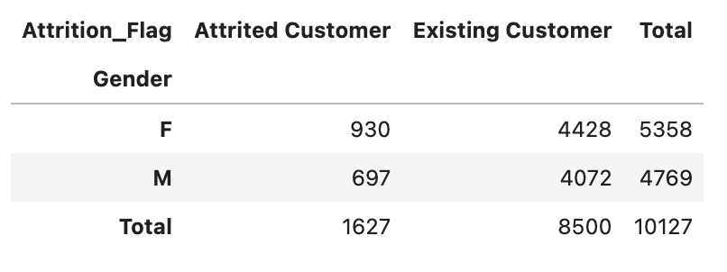
Exploratory Data Analysis
Attrition (Churn), Gender and the Card Type
930 female and 697 men are attrited customers, does that mean that women are more likely to be attrited?
Not necessarily! We need to see how many men vs female our data set contains more over we need to understand what is the likelihood of attrited customer out of isolation.
???
🤔

Slide 9
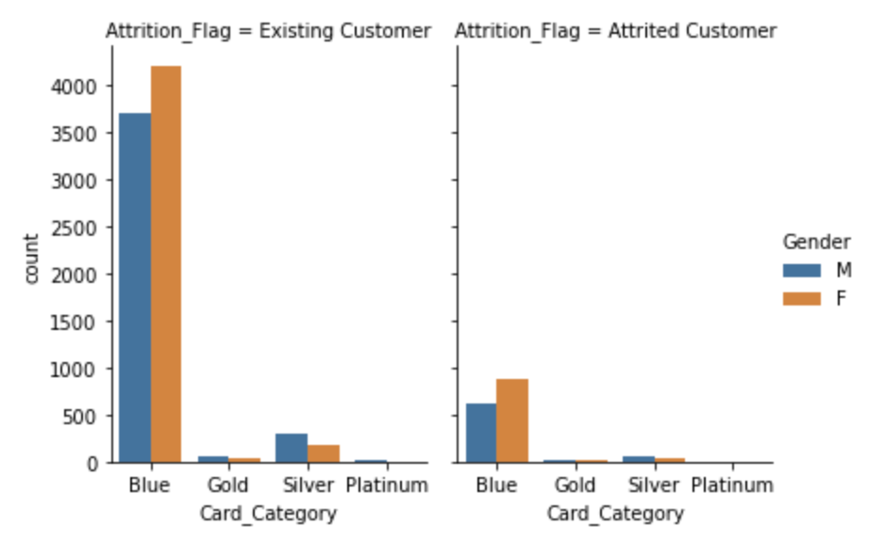
Exploratory Data Analysis
Attrition (Churn), Gender and the Card Type
This graph gives us more information and not enough to know what to do. We need to shift to probabilities. Let's see information in probabilities.
🙋‍♂️Pricing tiers are a problem for another day but we can see price buyers are a clear business issue.

Slide 10
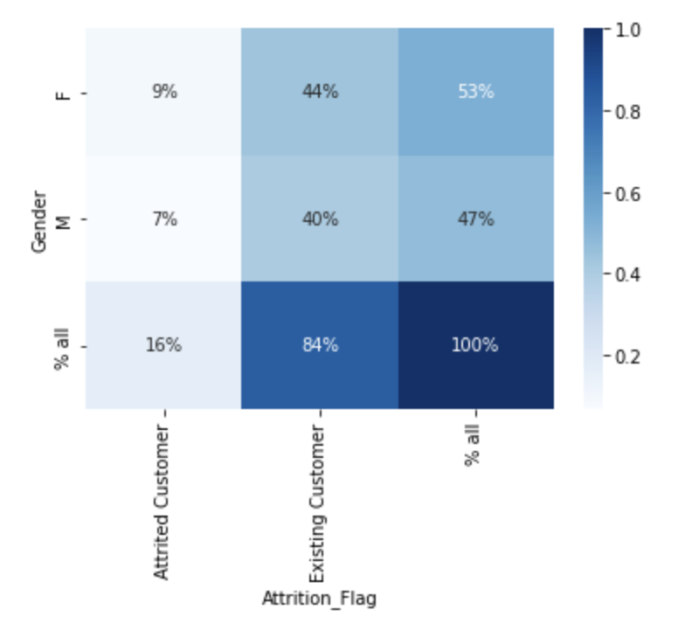
Exploratory Data Analysis
Gender Attrition and Customer Age Buckets
We can’t see big difference in gender attrition…So let’s move to age…

Slide 11
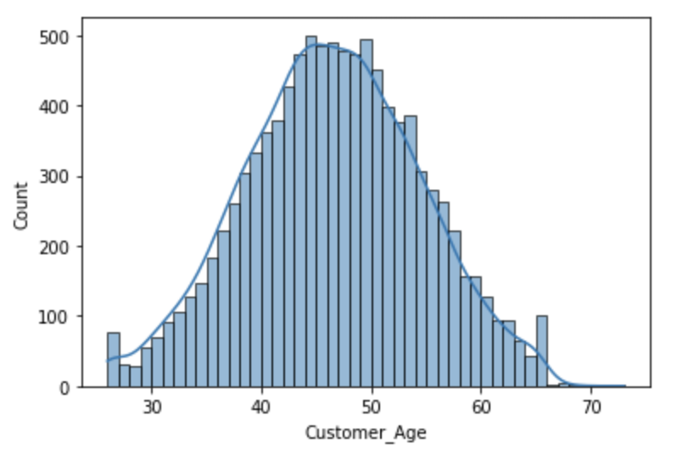
Exploratory Data Analysis
Gender Attrition and Customer Age Buckets
We can start breaking down the age groups, everything is slightly right distributed.

Slide 12
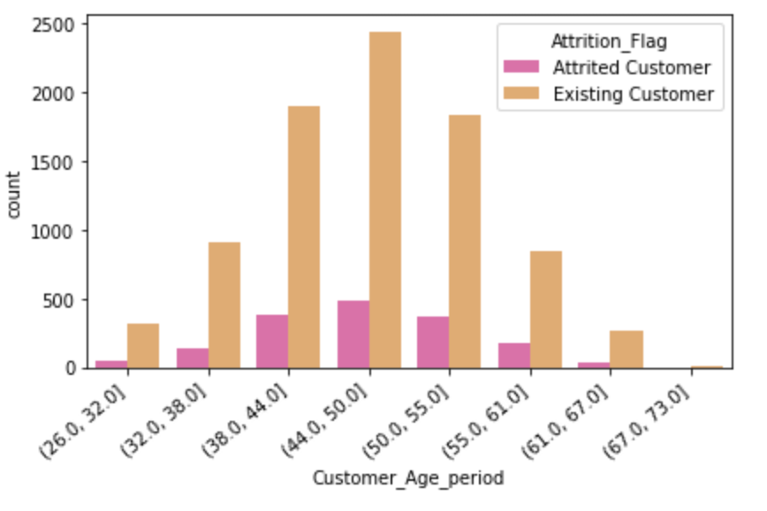
Exploratory Data Analysis
Customer Age Groups
8 bins seems to be the best fit to see the age over time period.

Slide 13
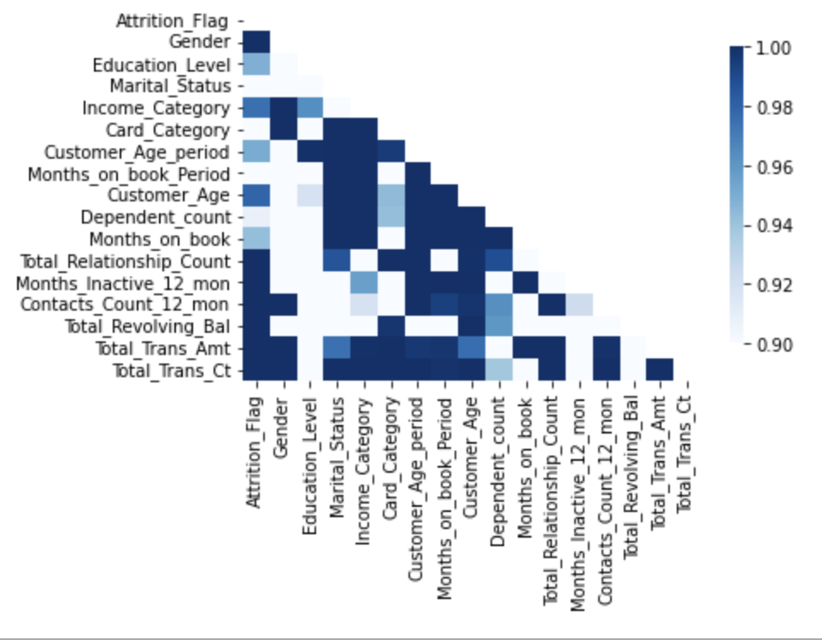
Exploratory Data Analysis
Correlation of Attrition Age
In the heatmap we can see that there is a dependency likelihood between Attrition_Flag (the target) and some of the other features. So the closer to 1 the greater likelihood for dependency.

Slide 14
Hypothesis Testing
Can We Reduce Churn on Macquarie Bank Credit Cards?
H0 (Null Hypothesis): No initial correlation.
H1 (Alternate Hypothesis): When computing p-value and utilising independence we can see a positive correlation with customer’s age (particularly 44-50yr olds) being the most probable way to predict churn.

Slide 15
Moving to a Desired Future State
What Decision-Making Steps Can We Take?
Key focus on reducing churn for customers 44-50 year olds
Customer interviews
Market research
Innovating price tiers to move customers into higher and more premium products, aligned with their income
Prompt users when activity is low
Increase credit card limits to those with lower revolving balance

Slide 16
Future Questions
Opportunities in Your Data
New question #1: Can we optimise higher price tiers for profitability?
New question #2: Can we improve customer experience when inactivity is low?

Slide 17
Q & A
Ask Me Anything
What?
Why?
How?
Potential Results?

Slide 18
Reed Iredale
0421 441 520
reed@reediredale.com

